Slide 1
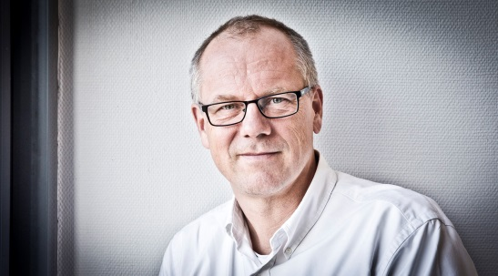
Addressing the second 90: How can treatment scale-up across the European region be accelerated?
Jens D. Lundgren
CHIP, Rigshospitalet, University of Copenhagen
Denmark

Slide 2





Quality of HIV-Care and Management – Benchmarking and Regional Differences across Europe
Addressing the second 90:
How can treatment scale-up
across the European region be accelerated?
Prof Jens Lundgren
CHIP, Rigshospitalet, University of Copenhagen
WHO Collaborative Centre on HIV, viral hepatitis and TB
Kamilla Grønborg Laut, MD
@ProfJLundgren

Slide 3
Disclosure
Relations that could be relevant for the meeting | Company
Institution received research funding from | Viiv, Gilead, MSD
I do not receive personal funding from any of the companies
Institution also received funding from:
NIAID, European Commission, Danish National Research Foundation

Slide 4
HIV control
Diagnose
and treat
STD’s
Treatment
of co-infections
and co-morbidity
Testing
for
HIV
+
linkage
to care
PrEP
Access to ART for all PLHIV
PEP
Promotion
of safe sex
behaviour
Retention in care
Limit transmission
Improve health for PLHIV

Slide 5
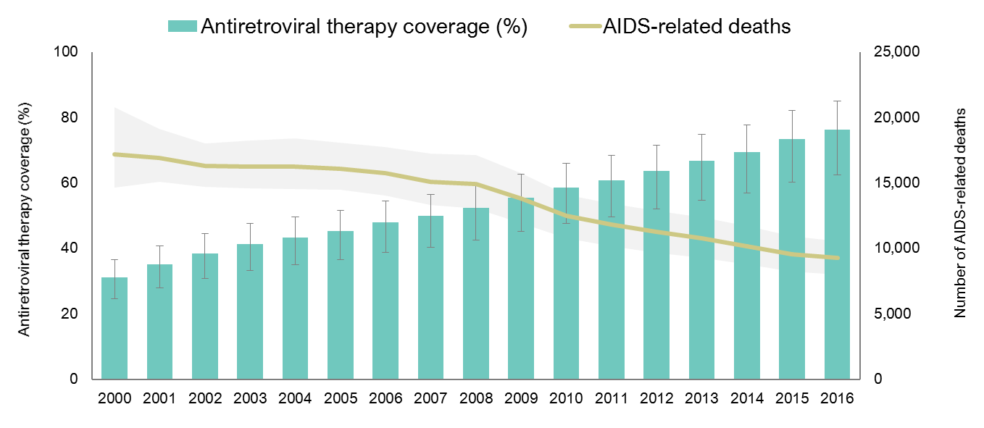
ART coverage and AIDS related deaths, Western and Central Europe,
2000-2016
Source: UNAIDS. Global AIDS Update 2017.

Slide 6
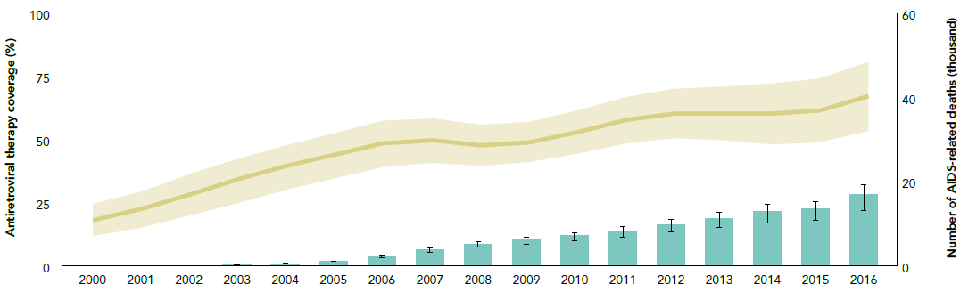
ART coverage and AIDS related deaths, Eastern Europe and Central Asia
2000-2016
Source: UNAIDS. Global AIDS Update 2017.

Slide 7
HIV treatment coverage by country
Eastern Europe and Central Asia, 2016
Source: UNAIDS. Global AIDS Update 2017.

Slide 8
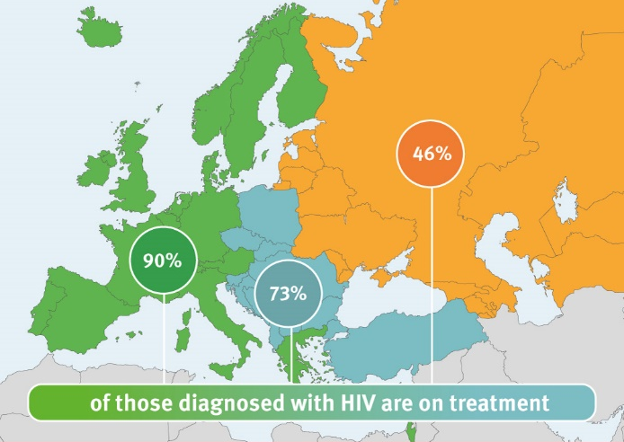
Progress toward achieving the second 90:
90% of those diagnosed on ART
Source: ECDC. Dublin Declaration monitoring 2018; validated unpublished data.

Slide 9
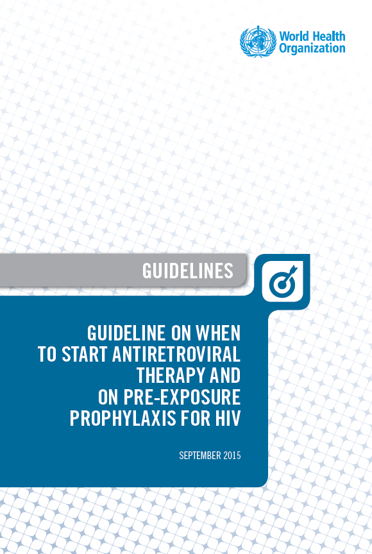
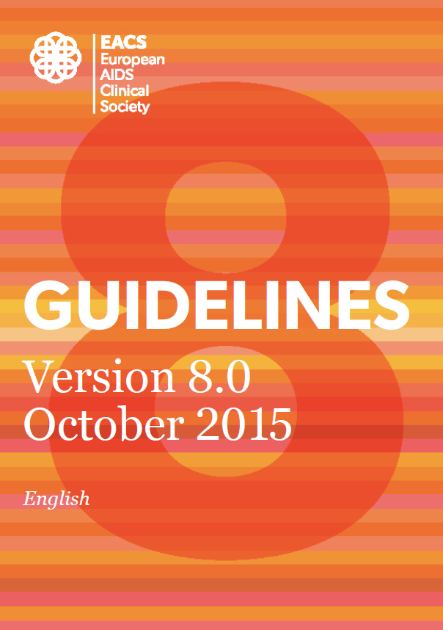
Policies on ART initiation in European countries 2014 (n=49), 2016 (n=47), 2018 (n=52)
2015
Source: ECDC. Dublin Declaration monitoring 2018; validated unpublished data.

Slide 10
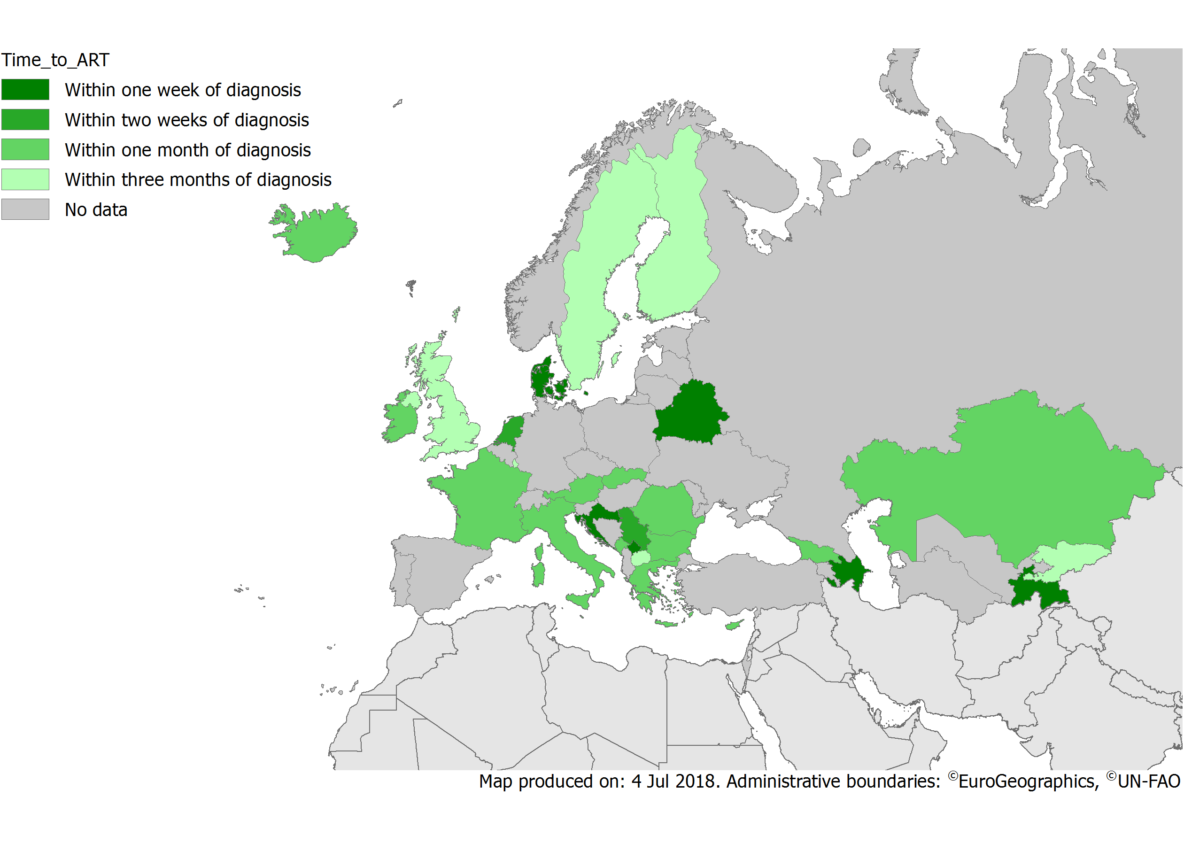
What is the average length of time between a confirmed HIV diagnosis and the start of treatment?
Source: ECDC. Dublin Declaration monitoring 2018; validated unpublished data.
Source: ECDC. Dublin Declaration monitoring 2018; validated unpublished data.

Slide 11
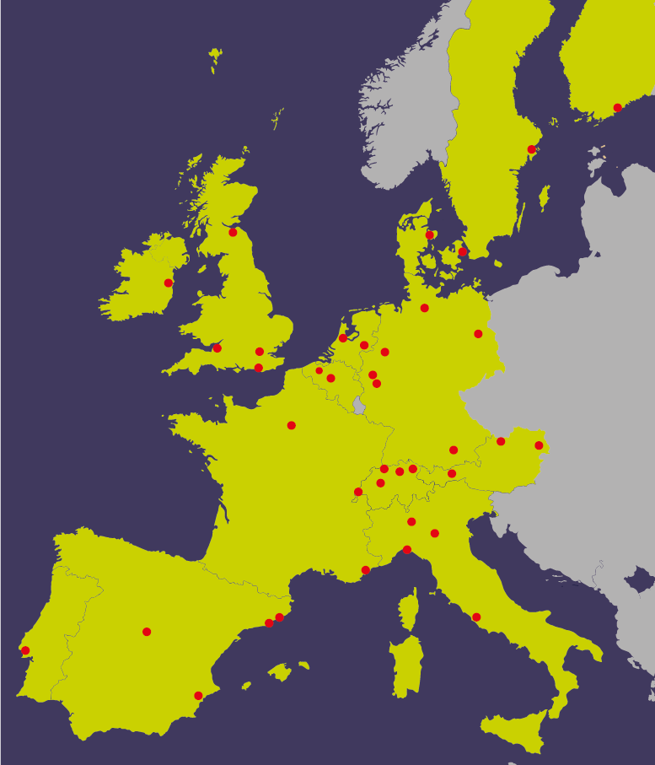
PARTNER Study
(Partners of people on ART: a New Evaluation of the Risks)
Design: an observational multi-centre study of HIV serodifferent couples (MSM and HT) in which the positive partner is on ART in 75 European clinical sites:
Phase 1: 2011-2014 (HT+MSM)
Phase 2: 2014-2018 (MSM only)
Primary Aim
To follow serodifferent partnerships that have penetrative sex without using condoms where the HIV-positive partner is on ART with a plasma HIV-1 RNA load <200 copies/mL to study risk of HIV transmission through anal sex in the absence of condom use
Rodger et al, #AIDS2018 (late breaker)

Slide 12
Country-specific estimates of people on ART and virologically suppressed
2004/05
West
South
North
East Central
East
Western Europe
Southern Europe
Northern Europe
East Central Europe
Eastern Europe
Percentage virologically suppressed among those on ART (%)
Bubble size,
number of people:
100
1000
Suppressed =
<500copies/mL
Percentage on ART among those in care (%)
EuroSIDA: Laut et al, Eurosurveillance 2018

Slide 13
Country-specific estimates of people on ART and virologically suppressed
2014/15
West
South
North
East Central
East
Western Europe
Southern Europe
Northern Europe
East Central Europe
Eastern Europe
Proportion virologically suppressed among those on ART (%)
Percentage virologically suppressed among those on ART (%)
Bubble size,
number of people:
100
1000
Suppressed =
<500copies/mL
EuroSIDA: Laut et al,
Eurosurveillance 2018
Percentage on ART among those in care (%)

Slide 14

RESPOND right side CoC project
AIM: Development of an online tool to assess % on ART and % virally suppressed (right side of CoC) on clinic/cohort level
Phase 1
Compare existing data in EuroSIDA with surveillance data from sites in Poland, Belarus, Georgia and Serbia
Explore sampling techniques of entire clinic population required to provide an accurate CoC
Phase 2
Standardised tool enabling clinics to establish CoC.
Clinics in other countries in region to validate prospectively the tool’s performance

Slide 15
Optimization
“making the best or most effective use of a resource”
8

Slide 16
Major Areas for ARV Optimization in HIV Therapy
Major Areas for ARV Optimization | efficacy and safety | simplification | harmonization | cost
Co-formulations | ↔ | ↑ | ↑ or ↔ | ↓
New drug class | ↑ | ↑ or ↔ | ↑ | ↓ or ↑
Dose adjustment | ↑ or ↔ | ↑ | ↑ or ↔ | ↓ or ↑
Drug manufacturing process | ↔ | ↔ | ↔ | ↓
New formulations | ↑ or ↔ | ↑ | ↑ | ↓
New strategies | ↑ or ↔ | ↑ | ↔ | ↓

Slide 17
Where Should Optimization Focus ?
The money saved from switching patients off of LPV/r is enough to scale up ART to those still in need of ART
In need of ART
150,000
1st line LPV/r
23,000
Notes:
Regimen TBD absolute number is 150,000, but if using 90-90-90 targets it is 110,000
These calculations are from UKRAINE example, April 2017

Slide 18
Enthusiasm for a treatment as a function of time since first entering clinical testing
Enthusiasm
Time since initiation of phase I trials (years)

Slide 19
First trimester exposure and possible teratogenicity
Efavirenz
  Birth defects (efv vs no efv; n=2,026):
    [RR] 0.78,
    [95% CI, 0.56–1.08]
  NTD (n=1/2,026):
    0.05%
    [95% CI, < 0.01 to 0.28]
Dolutegravir
NTD:
  0.9% (4 of 426) on DTG vs 0.1% (14 of 11,173) if on other ARV’s
  Study is ongoing – 600 additional pregnancies on DTG (Feb 2019)
Ford et al. AIDS. 2014;28 Suppl 2:S123-131 + announcement from EMA May 2018.

Slide 20
Response to dolutegravir/efavirenz based ART in persons on rimampicin-based TB treatment: interim report from INSPIRING trial
 | No. * | HIV-RNA viral load / CD4 count ** | HIV-RNA < 50 copies/mL @ week 24 (95% CI)
DTG 50 mg bid + 2NRTI’s | 69 | 5.10 log₁₀ c/mL / 208 cells/µL | 81% (95% CI: 72%, 90%)
EFV 600 mg qd + 2 NRTI’s | 44 | 5.24 log₁₀ c/mL 202 cells/µL | 89% (95% CI: 79%, 98%
*: randomised 3:2
**: CD4 count < 50 cells/µL excluded
Dooley et al, CROI 2018

Slide 21
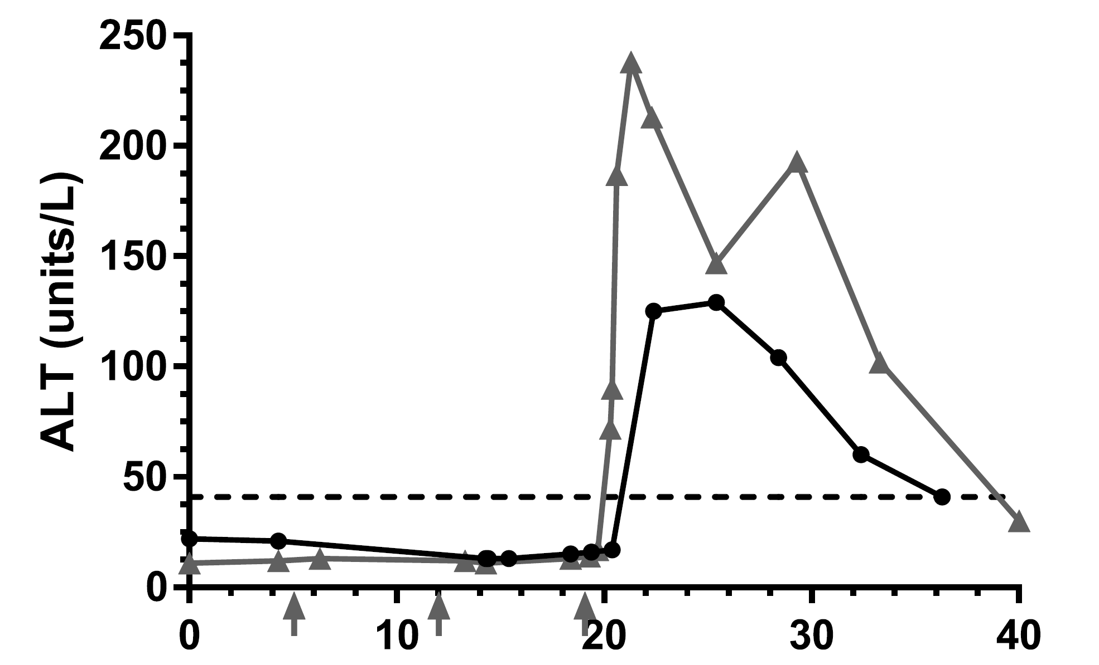
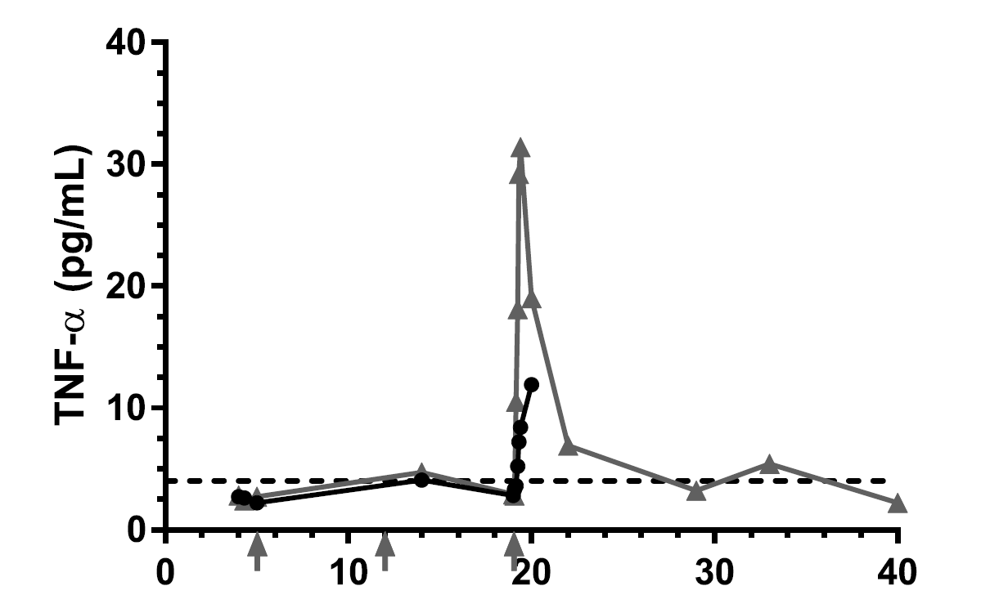
Dolutegravir (50 mg qd, day 0 - onwards) and Isoniazid and rifapentine (qw, day 4 – onwards) in 4 healthy persons: unexpected cytokine-storm related drug-induced liver injury in 2
Brooks et al, CID 2018

Slide 22
h
The case for ensuring
longterm pharmacovigilance
128 -
64 -
32 -
16 -
8 -
4 -
2 -
1 -
What we don’t know
Latency - time
What we know about
safety from trials
I I I I I
1 10 100 1000 10000
Frequency
Evans and Waller, MCA 2002

Slide 23
Summary of optimization profiles of new ARVs recommended in
2016 WHO ARV guidelines - comparative analysis
Optimization criteria |  | DTG | EFV400 | DRV/r | RAL
Efficacy and safety | High virologic potency | ✓ | ✓ | ✓ | ✓
 | Low toxicity | ✓ | ✓ | ✓ | ✓
 | High genetic barrier to resistance | ✓ | ✗ | ✓ | ✗
Simplification | Available as generic FDC | ✓ | ✓ | ✗ | ✗
 | Low pill burden | ✓ | ✓ | ✗ | ✗
Harmonization | Use in pregnant women | ? | ? | ✓ | ✓
 | Use in children | ? | ✗ | ✓ | ✓
 | Use in HIV-associated TB | (✓) | ? | ✗ | ✓
 | Few drug interactions | ✓ | ✗ | ✗ | ✓
Cost | Low price | ✓ | ✓ | ✗ | ✗
✓ yes ✗ no ? ongoing studies

Slide 24
Summary
Significant progress on 2nd 90 in last few years
  More robust scientific evidence
    All benefit health wise from starting early – limit active TB (incl MDR)
    Transmission is negligible if ART is fully suppressive
  Transformed into policy – pace varies though
Main focus areas
  Optimise linkage & retention in care
    Social and medical support structures if unstable lifestyle
    Enpower sites to construct their own “right side” of CoC
  Continue to optimize ART
    Continuous process
    Use highly effective and low cost / pt ART
    Pharmacovigilance remains paramount – interpret appropriately
  Continue to do research – health policy driven by evidence works

Slide 25
How close are we to reaching the 90-90-90 targets?
90%
81%
73%
Source: ECDC. Dublin Declaration monitoring 2018; validated unpublished data.

Slide 26

Acknowledgements
ECDC: Teymur Noori, Anastasia Pharris, Andrew Amato, et al
WHO-Europe: Masoud Dara; Elena Vovc, Annemarie Stengaard +
WHO country offices incl Alexey Bobrik, Martin Donoghoe, et al
Dedicated colleagues across the continent working hard to prevent HIV transmission and improve health in their setting
CHIP: Dorthe Raben, Anne Raahauge, et al

